Slide 1
Media Streaming With IBM Cloud video streaming

Slide 2
INTRODUCTION
Stream live, and manage recorded video content .
Cloud streaming platform for video hosting, transcoding, multi platforms playout, and analytics

Slide 3
IBM Cloud Video Streaming Overview
A Scalable, cloud-based online video platform that is an end -to-end for solution for live or on demand content to external audiences.
Managed from a dashboard by account administrators ,IBM video streaming supports both else-of-use and complex setups while being able to scale through built in multi-CND support.
Uses:
Employee communications
commercial or academic or public service virtual conferences
government proceedings
commertial promotion
concerts or other entertainment
other virtual services or events (weddings, funerals or religious services)

Slide 4
Key Features
HD Live broadcasting
Recording of broadcasts
Mobile compatible player
Video Distribution and work flow
Live chat and Q&A
Multi-CDNs
Quality of service player
Live playlists with looping
Customizable channel page

Slide 5
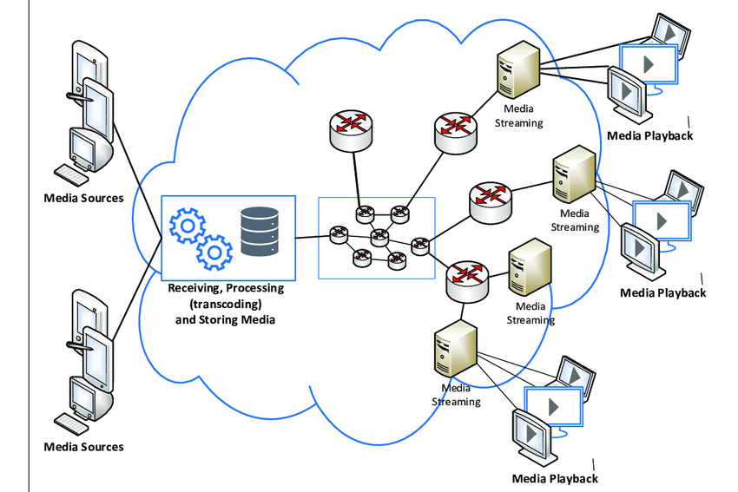
Architecture

Slide 6
Benifits
Ease of Accessibility.
Less hardware storage.
Ease of scalability.
Cost Effectively.
High-level data security.
Unlimited storage capacity.
Seamless playback.
Top CDN solution

Slide 7
THANK YOU

